Slide 1
Pairs Trading Strategy
Progress Report
Advisors: Dr Tao Pang, Mr Patrick Roberts
Group Leader: Chinna Gurram
Group Members: Harvey Hsu, Gavin Daniel, Sujal Kumar, Anish Kamath, Jaydon Hirschfield, Max Crisalli
Oct 9th, 2026
Notes:
Melanie

Slide 2







The Team
Chinna Gurram
crgurram@ncsu.edu
Max Crisalli
macrisal@ncsu.edu
Harvey Hsu
shsu5@ncsu.edu
Gavin Daniel
gdaniel2@ncsu.edu
Sujal Kumar
skumar64@ncsu.edu
Anish Kamath
askamath@ncsu.edu
Jaydon Hirschfield
jdhirsch@ncsu.edu
Notes:
Melanie

Slide 3
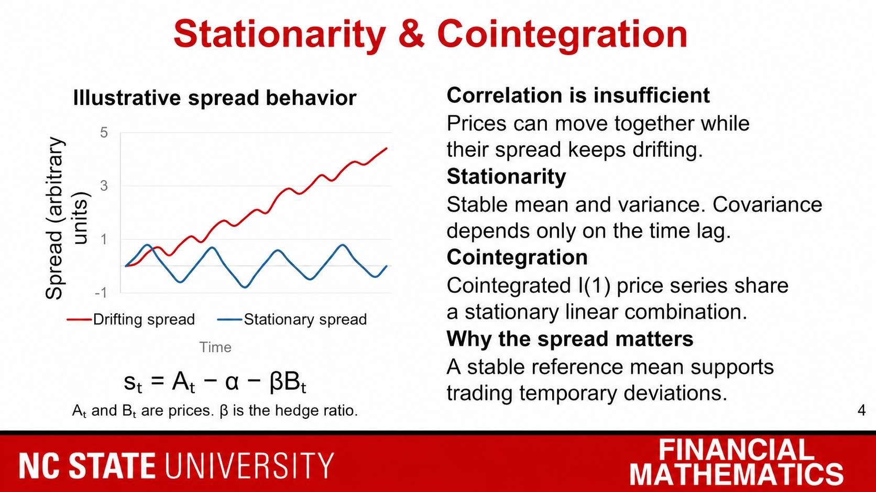
Notes:
For pairs trading, we need a reason to expect the gap between two assets to close. Correlation alone does not give us that. Two stocks can rise together because of the same market trend, while the difference between them keeps widening.
Stationarity means a series has a stable mean and variance over time. Its dependence between observations depends on how far apart they are, rather than when we observe them. In the chart, the blue spread fluctuates around a stable level, while the red spread drifts away. These are illustrative paths, not actual trading results.
Cointegration connects this idea to asset prices. Even if both price series are nonstationary, a particular weighted combination can be stationary. That combination is our spread, shown in the equation, where beta is the hedge ratio.
A stationary spread gives us a stable reference mean, which supports trading temporary deviations. We would check this using an Engle-Granger cointegration test, rather than relying on correlation. This provides evidence for the relationship, but it does not guarantee profitable convergence or tell us how quickly it happens. That leads into spread construction and mean-reversion speed.
TECHNICAL NOTES
Stationarity here means weak stationarity: constant finite mean and variance, with autocovariance depending only on the lag. I(1) means the levels are nonstationary but first differences are stationary. Cointegration applies to a nontrivial linear combination of I(1) series. The Engle-Granger null hypothesis is no cointegration. Use cointegration-specific residual-test critical values, not ordinary ADF critical values. Estimate and test with training data. Stationarity alone does not guarantee economically useful mean reversion.
SOURCES
Hyndman & Athanasopoulos, Forecasting: Principles and Practice, section 9.1: https://otexts.com/fpp3/stationarity.html
Statsmodels, Engle-Granger cointegration test documentation: https://www.statsmodels.org/v0.14.4/generated/statsmodels.tsa.stattools.coint.html
Chart: synthetic illustrative values, created only to explain spread behavior.

Slide 4
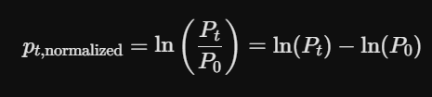

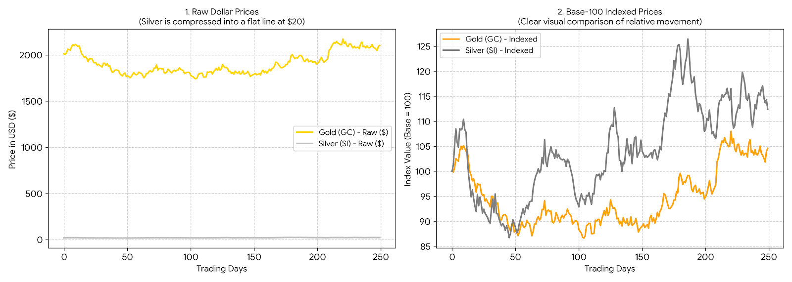


Spread Construction and Hedge Ratio
How is the hedge ratio calculated and the spread built ?
• Base-100 indexing v/s Log-price normalization
• We will construct a stationary portfolio by estimating the linear equilibrium parameter β via OLS Matrix Regression:
• Spread construction using residual
Notes:
First, Normalization. We applied Base-100 Indexing to align assets with vastly different nominal scales. For example, Gold trading in the thousands and Silver in the tens would create a huge bias in our analysis and trade strategy. So we index them in such a way that both start at 100, on equal playing grounds.
While Base-100 creates a clean visual baseline, the institutional standard is Log-Price Transformation. Natural logs convert geometric price compounding into linear additive relationships, removing base-date anchoring bias and ensuring our spread stays invariant to stock splits.
Second, estimating the Hedge Ratio ($\beta$). We run matrix-form linear regression on our normalized price series to solve for $\beta$
Economically, $\beta$ represents our relative sensitivity. In dollar terms, it dictates the exact position sizing - telling us how many units of Asset $X$ to short for every unit of Asset $Y$ we buy, ensuring our portfolio is market-neutral and insulated from systematic market risk. In log-price space, $\beta$ represents the price elasticity between the two assets, ensuring that systemic market movements cancel out and leave only the mean-reverting residual spread ($\epsilon_t$).

Slide 5
Spread Construction and Hedge Ratio
Rolling window calculations avoid look-ahead bias and adaptively update baseline mean and volatility.
Rolling Window Z-Score Standardization
Economic interpretation of residual (spread)
et < 0 : Y is undervalued as compared to X. Go long the spread.
et > 0: Y is overvalued as compared to X. Go short the spread.
et ≈ 0: The pair sits on its long-run line. α̂ is the standing offset; β̂ is the exchange rate between legs.
Entry Signals (|Zt| > Z*)
SHORT SPREAD SIGNAL
Short Asset Y + Long β Asset X when Zt > +Z* (Overvalued Spread).
LONG SPREAD SIGNAL
Long Asset Y + Short β Asset X when Zt < −Z* (Undervalued Spread).
Notes:
Finally, Spread Construction. The spread is simply our regression residual
Economically, this residual measures the short-term deviation from long-term economic equilibrium. Under cointegration, this spread is stationary and mean-reverting. By standardizing the spread into a rolling Z-score, any statistical breakout beyond our entry thresholds signals an arbitrage opportunity - letting us capitalize as prices inevitably revert to their mean.

Slide 6
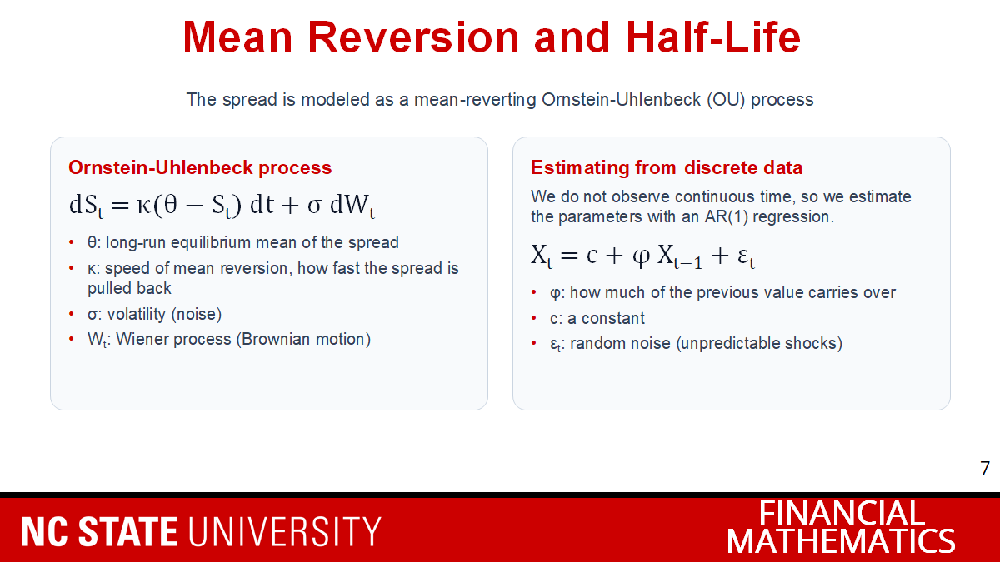
Mean Reversion and Half-Life
Notes:
Factor selection was driven by economic intuition across equity, fixed income, and macro regimes, and validated using correlation structure, stationarity, and multicollinearity diagnostics to avoid redundant or unstable exposures
We model the spread as an Ornstein-Uhlenbeck (OU) process, the standard model for mean reversion.
It pulls the spread back to the long-run mean θ at speed κ, plus noise σ.
We only see discrete data, so we estimate it with an AR(1) regression.
AR(1) is the discrete-time version of OU.

Slide 7
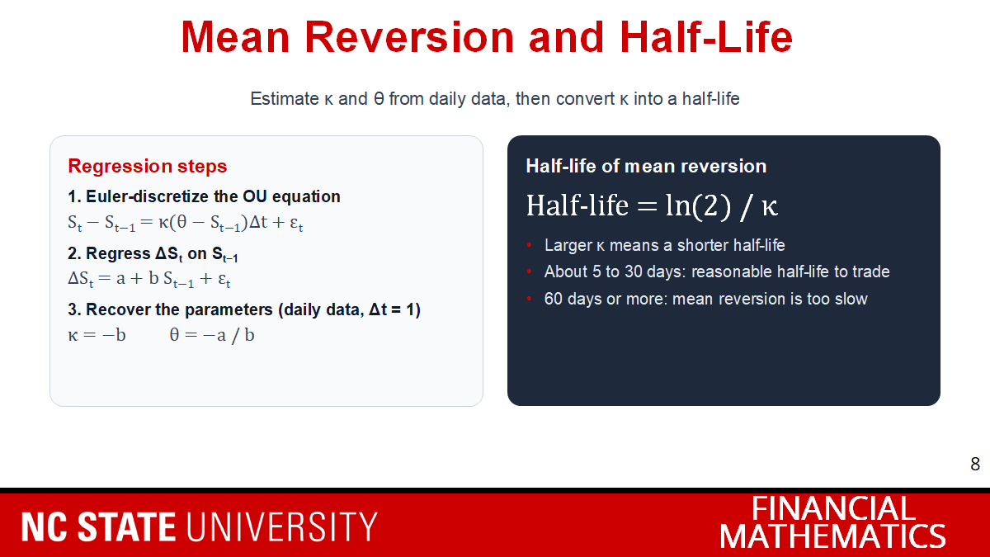
Mean Reversion and Half-Life
Notes:
Regress the daily change in the spread on the previous spread to get a and b.
Then κ = −b and θ = −a/b.
Half-life = ln(2) / κ: the time to close half the gap to the mean.
About 5 to 30 days is reasonable to trade; 60+ days is too slow.

Slide 8
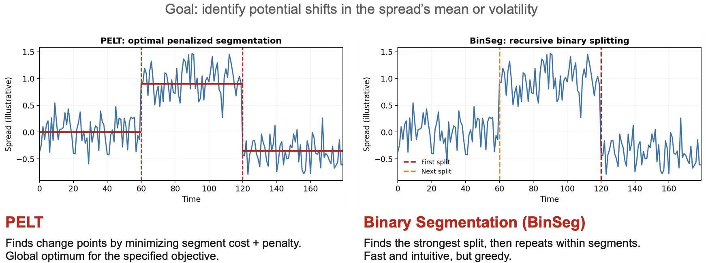
Regime Detection Algorithms

Slide 9
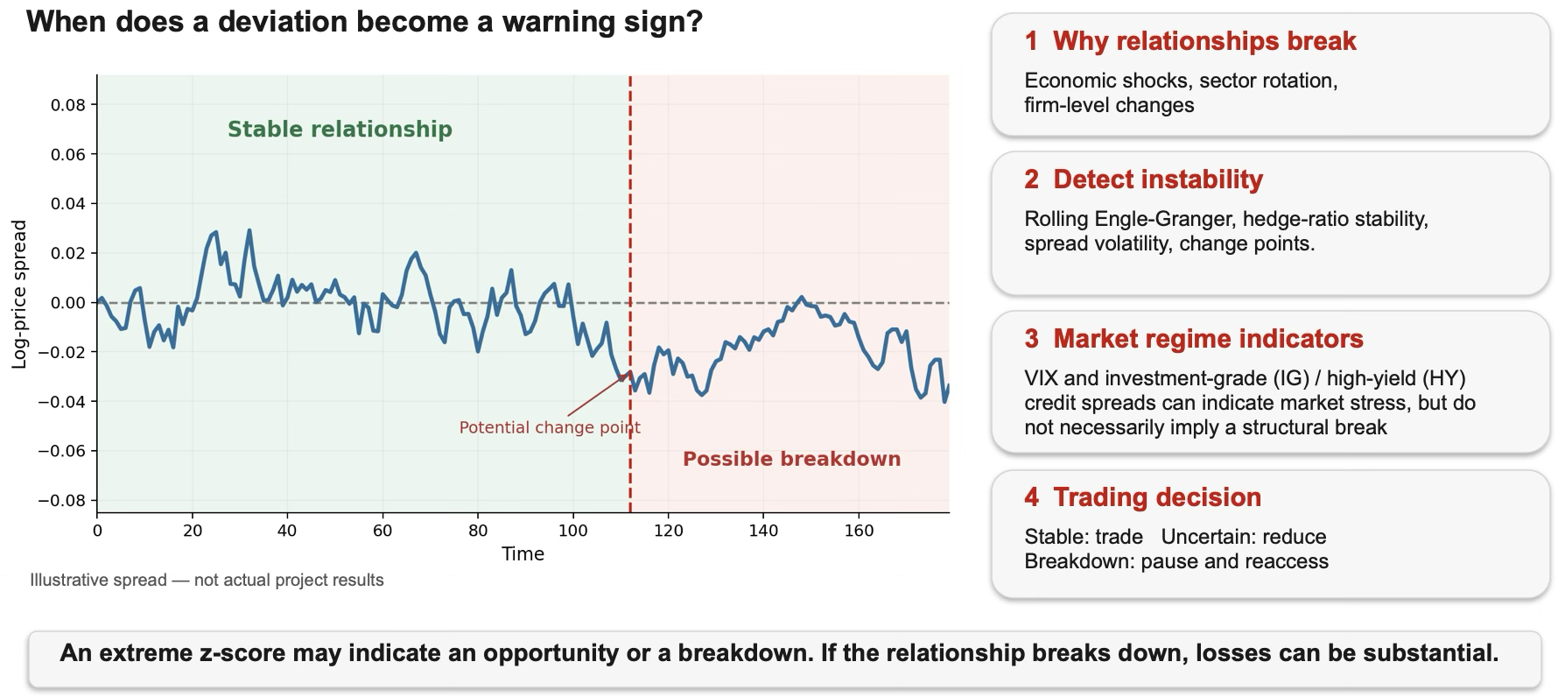
Regime Detection and Structural Breaks

Slide 10
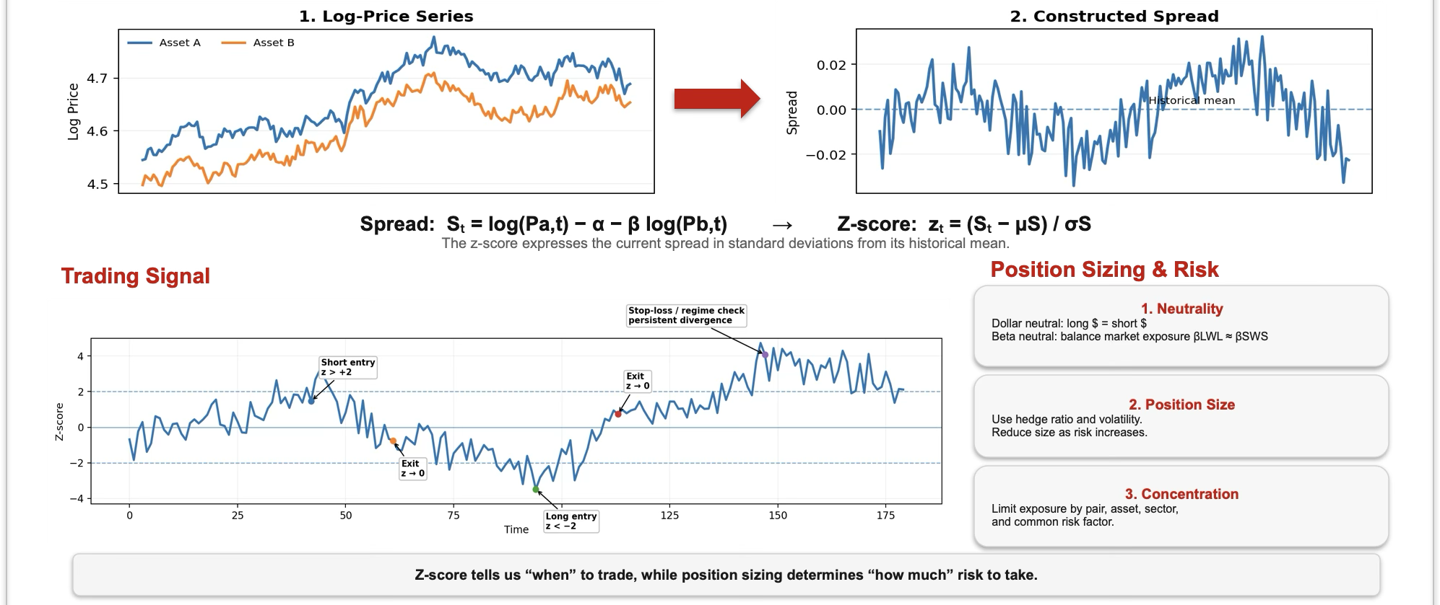
Signal Construction and Position Sizing
Notes:
Derek - From Chinna
We did a variety of tests univariate and bivariate to try discover patterns, anomalies, and check our assumptions
Drawdown analysis to better understand the underlying components (factors, sectors, strategies)
Returns distribution to help visualize the shape
QQ plots to give a more detailed view of how our data deviated vs normal. Better understanding of our tail risk
Our EDA didnt highlight any outliers or missing values. We were able to draw several key insights. Take this heatmap,
Equity factors are highly correlated.
Bond factors share rate and credit exposure.
Volatility moves opposite equities.
Correlations suggest multicollinearity risk.
planning to drop some of the equity factors as theyre too closely related to each other
Pass off to Shiqin

Slide 11
Backtesting and Performance Evaluation
Backtesting
  Simulating a strategy on historical data
Performance Evaluation
  Performance measures:
    Sharpe Ratio
    Win rate
    Maximum Drawdown
    Volatility
  Concerns:
    Look-ahead bias
    Survivorship bias
    Overfitting
Notes:
Shiqin still working

Slide 12
Next Steps
February
  Solidifying Data
  Model Selection & Fitting
October
  Model Backtesting
  Alpha Attribution
November
Notes:
Shiqin

